Slide 1
CS-512 Brain Inspired Computing Project Pitch Presentation
Presented By
Kush Pandya (kp1127), Kunjan Vaghela (kv353), Manan Shukla (ms3481), Dwijesh Shah (ds1991)

Slide 2
Plant disease recognition using Spiking Neural Network

Slide 3
Plant disease recognition using Spiking Neural Network - why is it important?
Applications (Plant Disease Recognition) :
For real time detection of diseases in large farms
Early Detection and Prevention: Early detection will allow prompt action, prevention of the spread of diseases and minimizing crop damage.
Precision Agriculture: Optimized use of resources, including water, pesticides, and fertilizers, promoting sustainable farming practices.
Economic Impact: Farmers can mitigate financial losses, making agriculture more economically sustainable.
Environmental Conservation: Targeted disease recognition contributes to environmentally friendly farming practices. Reduced use of pesticides and fertilizers, made possible by precise disease management through SNNs, helps minimize environmental impact.
Notes:
Early Detection and Prevention : To minimize crop damage.
Economic Impact : Farmers can mitigate financial losses.
Help Environmentally: Reduce use of pesticides and fertilizers.

Slide 4
Plant disease recognition using Spiking Neural Network - what others have done (basic literature review)?
Diverse Approaches:
  Varied CNN architectures (VGG16, ResNet-50, etc.)
  Transfer Learning
  Transformer models like ViT
Innovative Techniques:
  Techniques like EfficientNet-B0, C-DenseNet with CBAM, and M-bCNN enhance accuracy in wheat rust and leaf disease detection.
Dataset Exploration:
  Studies on multi-plant datasets like Plant Village, using transfer learning for improved performance. Segmentation and SVM applied for rice leaf disease.
Notes:
Advantage of other architecture:
Simplicity and Robustness of CNNs: well-established. They are known for their simplicity, robustness, and ease of implementation.
Transfer Learning: The learned features from large datasets can be beneficial when the target task has limited data.
Global Context Understanding in Transformer Models: Transformer-based models, such as Vision Transformers (ViTs) excel in capturing global context information from images
Advantages of SNN over others:
Biological Inspiration: SNNs draw inspiration from the human brain's neural firing mechanism, which will allow it to simulate more closely to the natural processes underlying plant health.
Temporal Dynamics: SNNs capture temporal dynamics, essential for understanding the progression of diseases over time, offering a more nuanced approach to diagnosis.
Energy Efficiency: SNNs inherently have lower energy consumption, making them suitable for resource-constrained environments.
Sparse Activation: SNNs exhibit sparse activation patterns, leading to more efficient computation and reduced computational requirements compared to dense activations in traditional architectures.

Slide 5
Conceptualized Approach
Dataset
Preprocessing
Encoding
Training
SNN Architecture Design
Validation
Testing
Evaluation

Slide 6
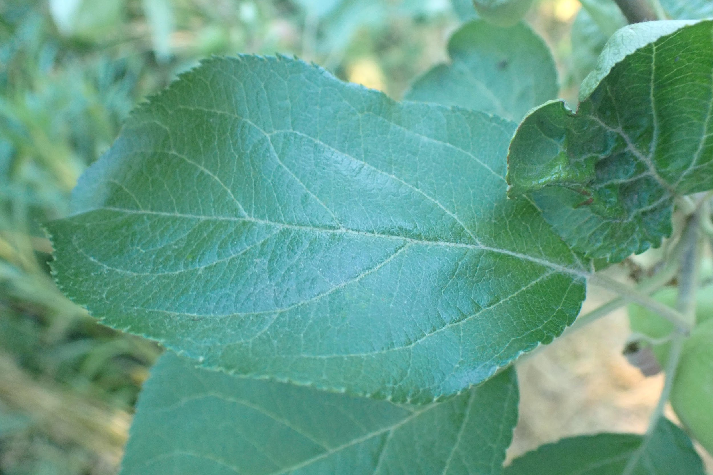
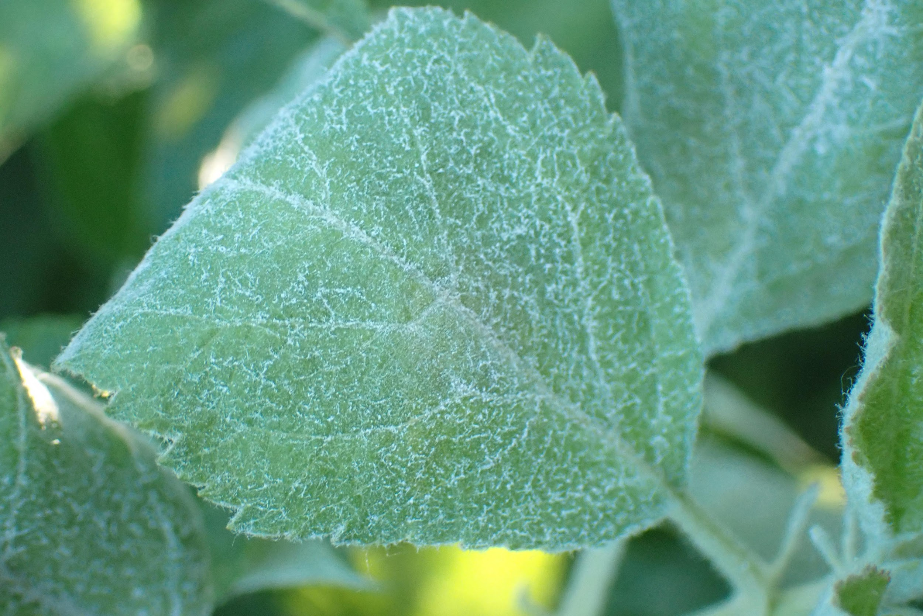
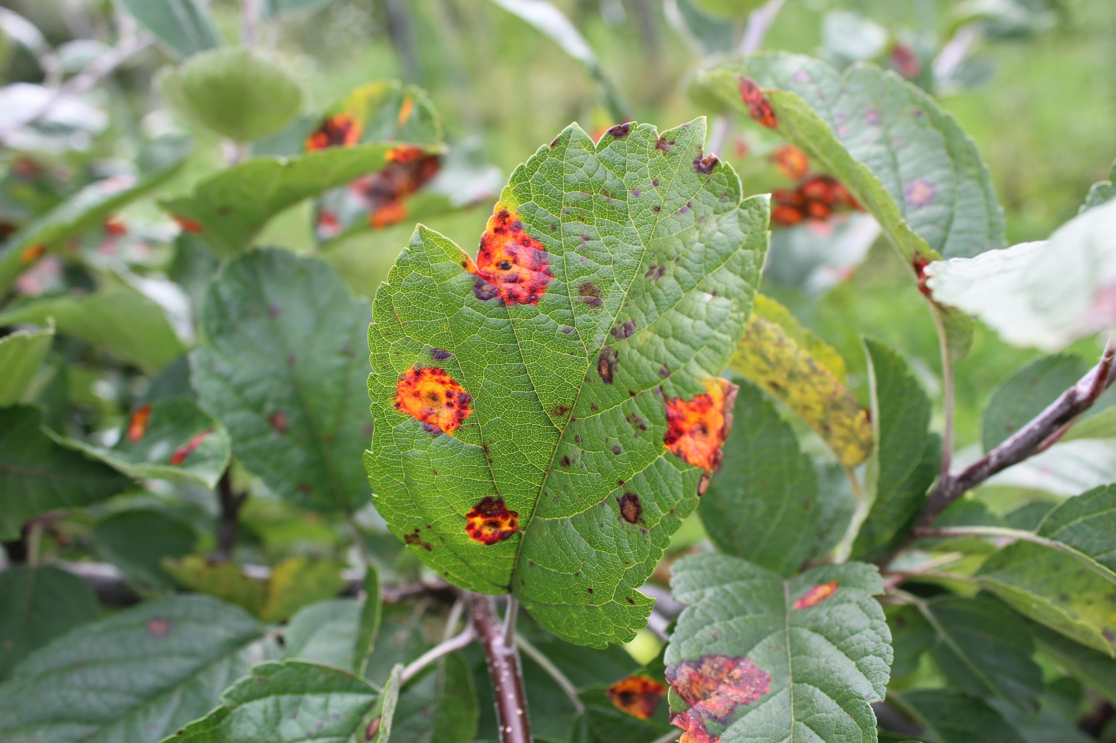
Plant disease recognition using Spiking Neural Network - Dataset
Dataset:
  Plant Disease Recognition Dataset
https://www.kaggle.com/datasets/rashikrahmanpritom/plant-disease-recognition-dataset
  Total data: 1532 image files, with dimension 4000 × 2500
  Labels : Healthy, Powdery and Rusty
  Split - Train:Test:Validation = 85:10:5
Preprocessing:
  Resize image to 256 x 256.
  Standardizing Pixels to between [0,1].
  Data Augmentation
Notes:
- After research we found this dataset on Kaggle called Plant Disease Detection Dataset
- It has 1532 ultra high definition images, their dimensions are 4000 x 2500
- The dataset is classified in 3 labels Healthy, Powdery and Rusty
- This is the split for the Dataset - 85% is for Training, 10% for Testing and 5% for Validation

Slide 7
Plant disease recognition using Spiking Neural Network (Continued…)
Python libraries exploration
  Focus is to find libraries compatible with Tensorflow
  Reason - The preprocessing pipeline in implemented in tensorflow.
SNN Libraries we think we should work with.
  BindsNet
  Nest
  Brian2

Slide 8
Experimentations
Idea is to compare the Normal CNN to SNN
Comparison will be made on
  training time. (To achieve Saturated loss in validation set)
  performance - ROC_AUC
  Saturated loss
We are planning to compare 5 to 6 types of networks to get a comprehensive overview.

Slide 9
Thank You
Notes:
Jingyi

